Slide 1
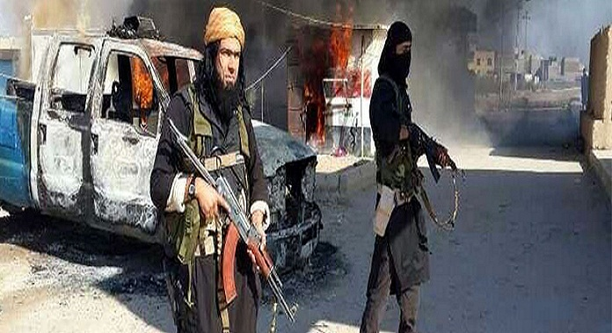
ISIS TERRORISM FROM A POLITICAL PSYCHOLOGICAL PERSPECTIVE
Assist. Prof. Dr. Ozan Örmeci
Girne American University

Slide 2
ISIS TERRORISM FROM A POLITICAL PSYCHOLOGICAL PERSPECTIVE
1. DEFINITION OF TERRORISM
«A symbolic act designed to influence the political behaviour by extranormal means, entailing the use or threat of violence» (Thornton, 1964: 73).
According to Martha Crenshaw, terrorism directed against governments has some political aims and it uses «symbolic, low-level violence by conspiratorial organizations» in order to give its political message (Crenshaw, 1981: 379).
«Illegal violence or threatened violence directed against human or nonhuman objects» (Gibbs, 1989: 330).

Slide 3
ISIS TERRORISM FROM A POLITICAL PSYCHOLOGICAL PERSPECTIVE
1. DEFINITION TERRORISM
«Non-state terrorism» can be explained as illegal and violent armed struggle for some political purposes. This definition shows clearly that terrorism has some «preconditions – factors that set the stage for terrorism over the long run» and «precipitants – specific events that immediately precede the occurrence of terrorism» (Crenshaw, 1981: 381).
Terror in general has two elements: (1) the aim to shape political behaviours, (2) the use of extraordinary violence.

Slide 4
ISIS TERRORISM FROM A POLITICAL PSYCHOLOGICAL PERSPECTIVE
2. SYMBOLIC TERROR
Geoffrey Galt Harpham in his article «Symbolic Terror» analyzes the effects of terrorist acts especially that of September 11 (9/11) incident.
He thinks that terror itself may not symbolic but its effects are registered in the symbolic domain. Terror affects the symbolic realm in two different ways. First, terrorism changes the current political-military order and leads to something different at least makes people believe that they live in a radically different period because of fear, paranoia and anxiety. Secondly, terrorism, by disseminating numerous messages, creates a world of symbolic order.

Slide 5
ISIS TERRORISM FROM A POLITICAL PSYCHOLOGICAL PERSPECTIVE
2. SYMBOLIC TERROR
Harpham believes that the Cold War and imperialism prepared necessary grounds for terrorism (Harpham, 2002: 574).
It is also used as a pretext by American government to intervene in Iraq in 2003. Kenneth Adelman: «I have no evidence that Iraq was involved in 9/11, but I feel it» (Harpham, 2002: 575).
The left sees American policies as the reason of terrorism. Noam Chomsky for instance reveals that 9/11 represents nothing but the “the logical outcome of American policies and actions” (Harpham, 2002: 577).

Slide 6
ISIS TERRORISM FROM A POLITICAL PSYCHOLOGICAL PERSPECTIVE
3. PSYCHOLOGY OF TERRORISM
Difficult to categorize for several reasons;
Difficulty of comparing various kinds of terrorist organizations in different regions: Marxist, Nationalist, Radical Islamist terrorist organizations.
Different types of terrorist organizations: Loose network (Al Qaeda) vs. Strong centralism, Transnational (PKK, Al Qaeda) vs. National or Local.
Methods employed: Bombings, Kidnapping, Cyber attacks, towards state officials vs. towards civilians.

Slide 7
ISIS TERRORISM FROM A POLITICAL PSYCHOLOGICAL PERSPECTIVE
3. PSYCHOLOGY OF TERRORISM
Terrorist Psychology: There is no clear evidence for «terrorist psychology» (Crenshaw, 1985: 385) or a widespread psychological pathological pattern (Rasch, 1979: 80). R.R. Corrado’s studies on IRA militants also strengthen this argument (Corrado, 1981).
Sociological Theories:
Social Disorganization Theory (Chicago School)
Social Control Theory (Travis Hirschi)
Socialization Theory (Robert Merton)

Slide 8
ISIS TERRORISM FROM A POLITICAL PSYCHOLOGICAL PERSPECTIVE
3. PSYCHOLOGY OF TERRORISM
3. Fundamentalism: It means the demand for a strict adherence to certain theological doctrines, being hostile to secularism and other views/religions/sects/lifestyles (Marty, M.E. & R.S. Appleby: 1995: 1).
- Fundamentalists are different from pious people in their strict categorization of themselves from other people and their strong tendency to use violence. (But there are fundamentalist groups rejecting violence too. e.g.: Old Believers in Estonia, Gülen community in Turkey).

Slide 9
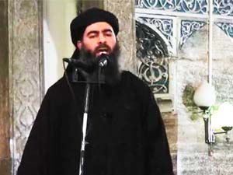
ISIS TERRORISM FROM A POLITICAL PSYCHOLOGICAL PERSPECTIVE
4. ISIS/ISIL/IS/DAESH
Name: Islamic State of Iraq and Syria or Islamic State of Iraq and ash-Sham (ISIS), Islamic State of Iraq and the Levant (ISIL), Islamic State (IS) or ad-Dawlah al-Islāmiyah fīl-ʿIrāq wash-Shām (DAESH).
Leader: Abu Bakr al-Baghdadi who was proclaimed as the Caliph.

Slide 10
ISIS TERRORISM FROM A POLITICAL PSYCHOLOGICAL PERSPECTIVE
4. ISIS/ISIL/IS/DAESH
Establishment: ISIS, in fact is not a new organization. It was established in 2003 by Abu Musab al-Zarqawi under the name of Jama’at al-Tawhid wal-Jihad. It is based on Salafism and welcomes terrorist methods for the defense of Islamist lands.
Aim: The aim of ISIS is to establish an Islamic state with a caliphate in the lands of Syria and Iraq.
Leadership change: Abu Bakr al-Baghdadi became the leader of ISIS in 2010.
Two deputy leaders: Abu Muslim al-Turkmani (KIA) for Iraq and Abu Ali al-Anbari for Syria.

Slide 11
ISIS TERRORISM FROM A POLITICAL PSYCHOLOGICAL PERSPECTIVE
4. ISIS/ISIL/IS/DAESH
Governance: Alonside with the leader and two deputy leaders, there are 12 local governors in Iraq and Syria. Beneath the leaders are councils on finance, leadership, military matters, legal matters—including decisions on executions—foreign fighters' assistance, security, intelligence and media. In addition, a Shura Council has the task of ensuring that all decisions made by the governors and councils comply with the group’s interpretation of sharia. The majority of the ISIL’s leadership is dominated by Iraqis, especially among former members of Saddam Hussein’s regime.

Slide 12
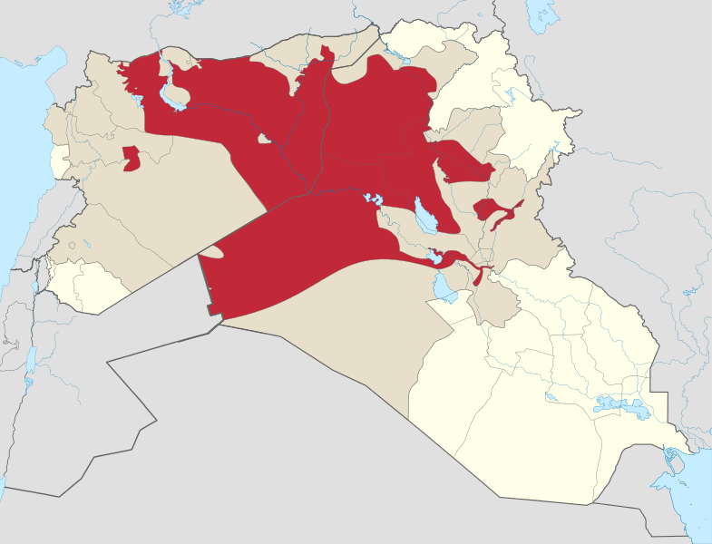
ISIS TERRORISM FROM A POLITICAL PSYCHOLOGICAL PERSPECTIVE
4. ISIS/ISIL/IS/DAESH
Territorial control of the ISIS

Slide 13
ISIS TERRORISM FROM A POLITICAL PSYCHOLOGICAL PERSPECTIVE
4. ISIS/ISIL/IS/DAESH
ISIS gained power after the removal of American troops from Iraq.
Arab Spring turning into Arab Winter also helped ISIS to expand their controlled areas.
ISIS employed increadiblely violent methods (beheadings of Christians, Yazidis, foreign journalists, strict implementation of Sharia law, burning people etc.) to spread fear and take over Syrian and Iraqi cities.
These methods helped the organization to control large areas in Iraq and Syria without even fighting.

Slide 14
ISIS TERRORISM FROM A POLITICAL PSYCHOLOGICAL PERSPECTIVE
4. ISIS/ISIL/IS/DAESH
Economic sources: Zachary Laub from CFR states that the ISIS operates like a criminal organization. Main economic benefits come from extortion, theft, smuggling, oil and weapon trade.
Function: - ISIS draws the new maps of the region although it is not very clear which countries support this terrorist organization. This might lead to a possible independent Kurdistan state or states in northern Iraq and Syria.
Defamation of Islam as a religion of peace by strengthening Islamophobia.
Political instabilities in the region.
Refugee problem in Turkey and Jordan.
Return of power politics and harsh anti-terror measures.

Slide 15
ISIS TERRORISM FROM A POLITICAL PSYCHOLOGICAL PERSPECTIVE
BIBLIOGRAPHY
Corrado, R. R. (1981), “A Critique of the Mental Disorder Perspective of Political Terrorism”, International Journal of Law and Psychiatry, 4.
Crenshaw, Martha (1981), “The Causes of Terrorism”, Comparative Politics, Vol. 13, No: 4, July 1981.
Crenshaw, Martha (1985), “The Psychology of Political Terrorism” in Political Psychology ed. by Margaret H. Hermann, San Francisco: Jossey-Bass. Available at: http://www.law.syr.edu/pdfs/0political_psychology.pdf.
Gibbs, Jack P. (1989), “Conceptualization of Terrorism”, American Sociological Review, 54, 3.
Harpham, Geoffrey Galt (2002), “Symbolic Terror”, Critical Inquiry, Vol. 28, No: 2, Winter 2002. Available at: http://www.jstor.org/discover/10.2307/1344283?uid=3739192&uid=2&uid=4&sid=21104301490337.
«Islamic State of Iraq and the Levant», Wikipedia, Available at: http://en.wikipedia.org/wiki/Islamic_State_of_Iraq_and_the_Levant.
Laub, Zachary (2014), “Islamic State in Iraq and Syria”, Council on Foreign Relations, Available at: http://www.cfr.org/iraq/islamic-state-iraq-syria/p14811.
Marty, M.E. and R.S. Appleby (1995), Fundamentalism Comprehended, Chicago: University of Chicago Press.
Örmeci, Ozan (2014), «IŞİD Nedir ve Ne İstiyor?», Uluslararası Politika Akademisi, Available at: http://politikaakademisi.org/isid-nedir-ve-istiyor/.
Rasch, W. (1979), “Psychological Dimensions of Political Terrorism in the Federal Republic of Germany”, International Journal of Law and Psychiatry, 2.
Thornton, T.P. (1964), “Terror as a Weapon of Political Agitation” in H. Eckstein (ed.), Internal War: Problems and Approaches, New York: Free Press.
Volkan, Vamık D. (2009), “Religious fundamentalism and violence”, in On Freud’s “Future of an Illusion”, (Eds.) Salman Akhtar, and O’Neil, M., London: Karnac Books. Available at: http://www.vamikvolkan.com/Religious-Fundamentalism-and-Violence.php

