Slide 1
International Crises and Crisis Management
1. Terminology
Crisis:
A time of ​great ​disagreement, ​confusion, or ​suffering.
An ​extremely ​difficult or ​dangerous ​point in a ​situation.
International Crisis:
A sequence of interactions between the governments of two or more sovereign states in severe conflict, short of actual war, but involving the perception of a dangerously high probability of war.

Slide 2
International Crises and Crisis Management
2. Characteristics of International Crises
Rarely seen but causing damage,
Threatening priorities of the decision-makers,
Limited time between thinking/planning and action,
Creating unexpected conditions/risks for the decision-makers,
Causing a sudden change in the status quo,
Making decision-makers unable to see the full picture and to predict what is coming,
Causing lack of trust between opposing camps.

Slide 3
International Crises and Crisis Management
3. Steps of International Crises
A-) Pre-crisis: Conditions are already evolved at this point, but the crisis did not start yet.
B-) Escalation of crisis: Crises start and deepen with a sudden and shocking event and lead to demonstrations and angry reactions on both sides.
2 possible outcomes;
C-) Detente: With efforts on both sides, the effects of the crises can be minimized and the crisis can be eliminated in a reasonable time period.
D-) Eruption: International crises might lead to wars and military confrontations if there is no detente.

Slide 4
International Crises and Crisis Management
4. Types of International Crises
A-) Gradual piling up crisis: Some of the international crises appear in time gradually with the emergence and deepening of conflicting conditions. (Arab-Israeli conflict)
B-) Unexpected crisis: Some crises begin without earlier reasons suddenly with a provocating event. (Recent jet crisis between Turkey and Russia, 9/11)
C-) Planned crisis: One of the sides might plan the crisis in advance. (Anchuluss between Nazi Germany and Austria)
D-) Indirect crisis: Crises that have spill-over effects over the third countries. (NATO-Russia confrontation over Turkey)
E-) Accidental crisis: Crises that appear due to an accident. (EP-3 crisis or Hainan Islands incident)

Slide 5
International Crises and Crisis Management
5. Categories of International Crises based on their themes
A-) Security crisis: Crises based on concrete geopolitical disagreements or conflicts over security-based issues. (Israel-Iran and US-Iran crisis over the Iranian nuclear program)
B-) Interest-based crisis: Some crises take place due to conflicting national interests based on economic or political competition. (US-Russia confrontation over Syria)
C-) Confidence crisis: Lack of trust towards two sides might lead to international crises. (Senkaku Islands crisis between Japan and China)
D-) Information crisis: It is based on disinformation and propaganda. (Iraqi War initiated by US upon WMDs)

Slide 6
International Crises and Crisis Management
6. Crisis Management
In times of crisis, people look at their PM/President/Managers, in short their leaders. We expect these policy makers to avert the threat or at least minimize the damage of the crisis. They should lead us out of the crisis; they must explain what went wrong and convince us that it will not happen again. This process is often called as the «crisis management».
Crisis management is the process by which a country tries to deal with a major event, country or a terrorist group that threatens to harm its security. Although crisis management strategy is closely associated with business management and firms, it is also used in international relations by countries and decision-makers.

Slide 7
International Crises and Crisis Management
6. Crisis Management
There might be offensive and defensive strategies in crisis management:
Offensive strategies: blackmail, limited and reversible response, controlled pressure, attrition, fait accompli.
Defensive strategies: coercion, limited escalation, tit-for-tat, test of capabilities, drawing a line, buying time strategy, conveying commitment and resolve to avoid miscalculation by the adversary.

Slide 8
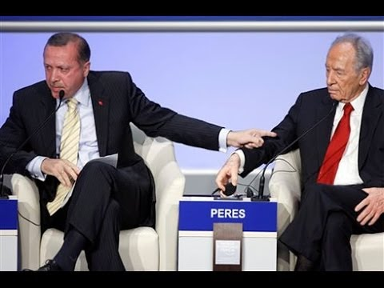
International Crises and Crisis Management
Turkish PM Recep Tayyip Erdogan vs. Israeli President Shimon Peres (World Economic Forum at Davos in January 2009)

Slide 9
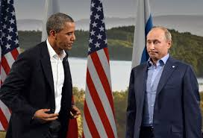
International Crises and Crisis Management
US President Barack Obama and Russian President Vladimir Putin (G8 Summit in Northern Ireland in June 2013)

Slide 10
International Crises and Crisis Management
BIBLIOGRAPHY
Arjen Boin & Paul ’t Hart & Eric Stern & Bengt Sundelius (2006), The Politics of Crisis Management: Public Leadership Under Pressure, Cambridge University Press.
Cambridge Dictionaries Online, http://dictionary.cambridge.org/.
«Crisis Management», Wikipedia, https://en.wikipedia.org/wiki/Crisis_management.
Çakmak, Haydar (2000), Uluslararası İlişkiler (Giriş, Kavram ve Teoriler), Ankara: Barış Platin Yayınları.
«International Crisis», Wikipedia, https://en.wikipedia.org/wiki/International_crisis.

